Slide 1
Plant Reproduction

Slide 2
WORD HUNT

Slide 3
A | D | S | P | O | L | I | N | A | S | I | E
I | I | A | O | R | X | C | O | L | D | N | H
M | M | N | C | N | O | A | K | S | T | L | C
A | A | E | E | I | Z | I | D | O | R | S | A
G | G | M | I | T | S | M | M | R | T | U | O
O | O | O | T | O | F | O | O | F | W | H | A
P | N | G | N | G | G | S | N | O | K | E | S
O | O | A | A | A | L | L | O | G | A | M | I
R | T | M | I | M | O | C | E | S | A | N | T
T | I | H | B | I | U | I | A | C | U | T | E
N | E | S | E | M | N | E | C | D | N | A | S
A | G | O | R | A | U | T | O | G | A | M | I

Slide 4
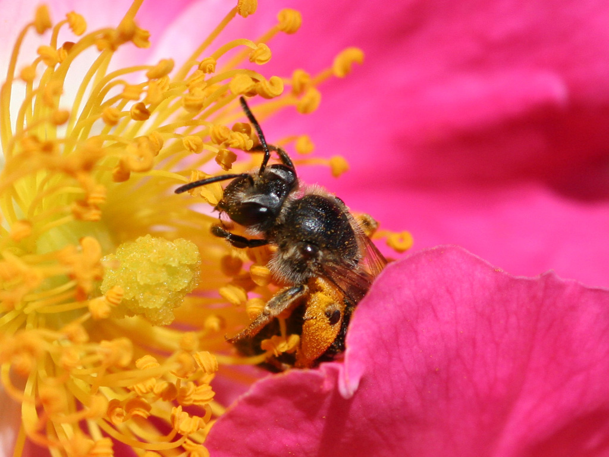
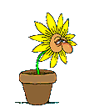
pollination
It is the act of transferring pollen grains from the male anther of a flower to the female stigma.

Slide 5
Can you name an animal/insects that involved in pollination?

Slide 6
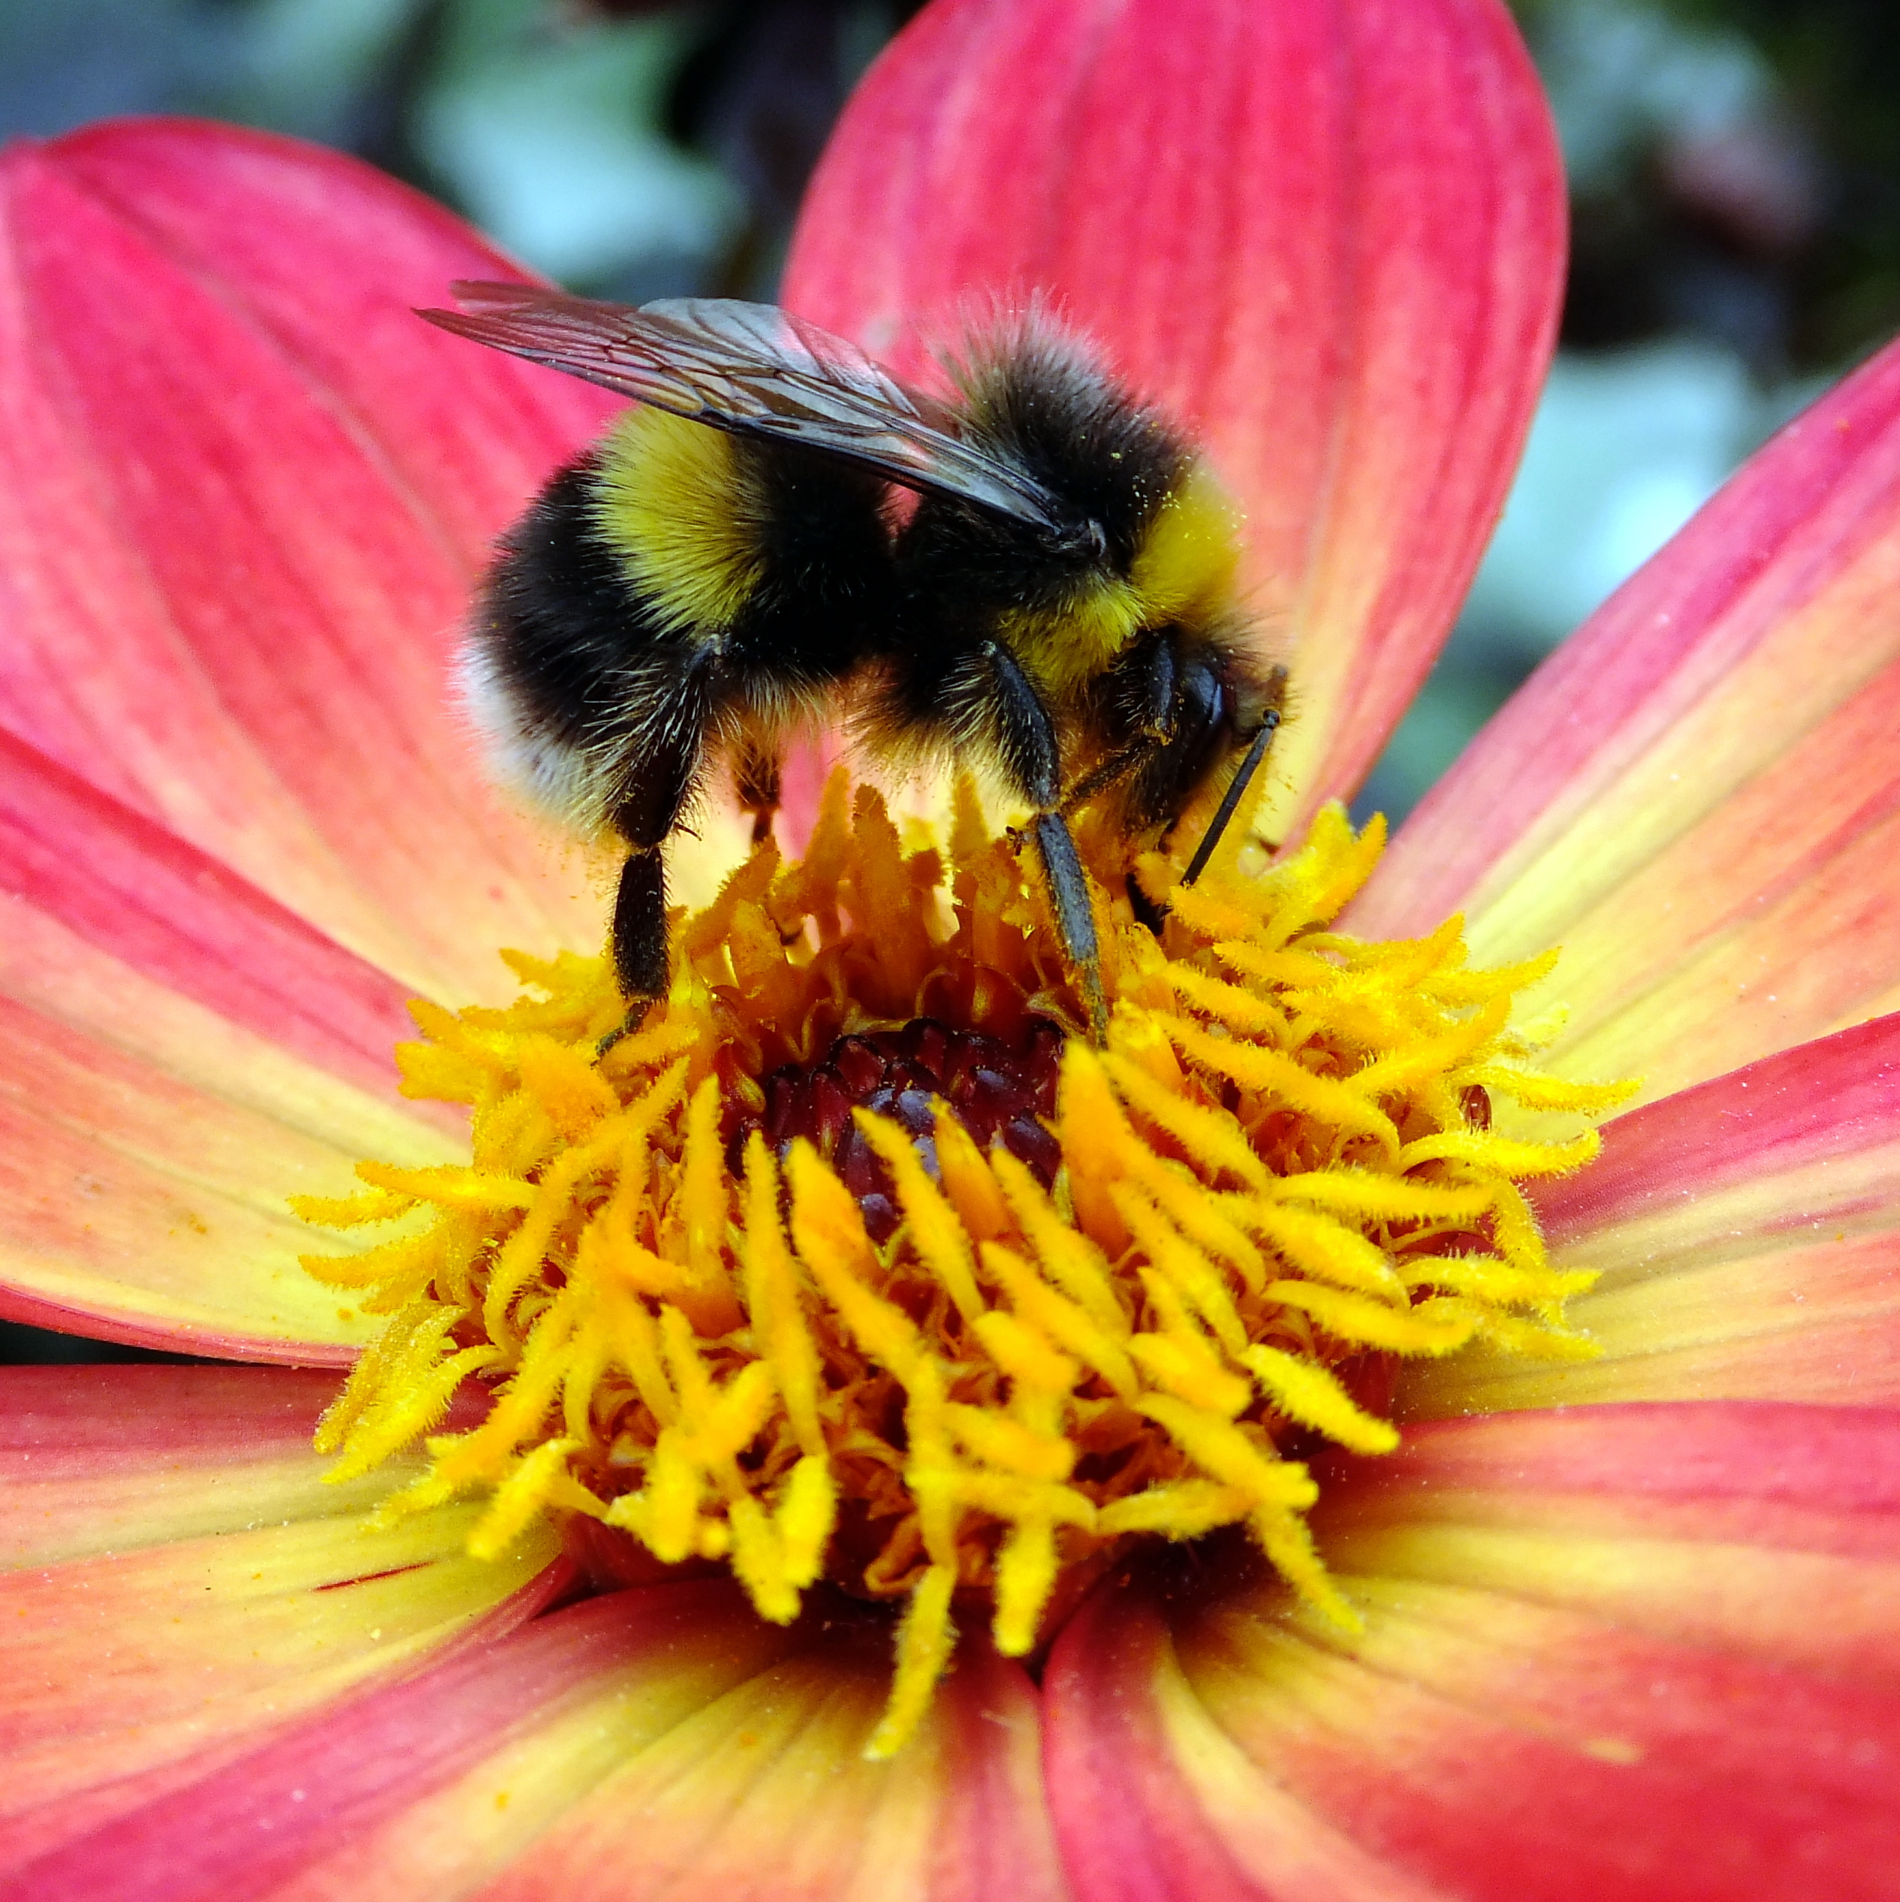
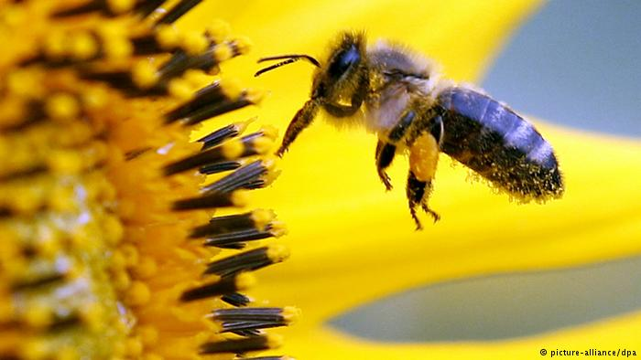
What do you see in this picture?
What do you think are bees taken from flowers?

Slide 7
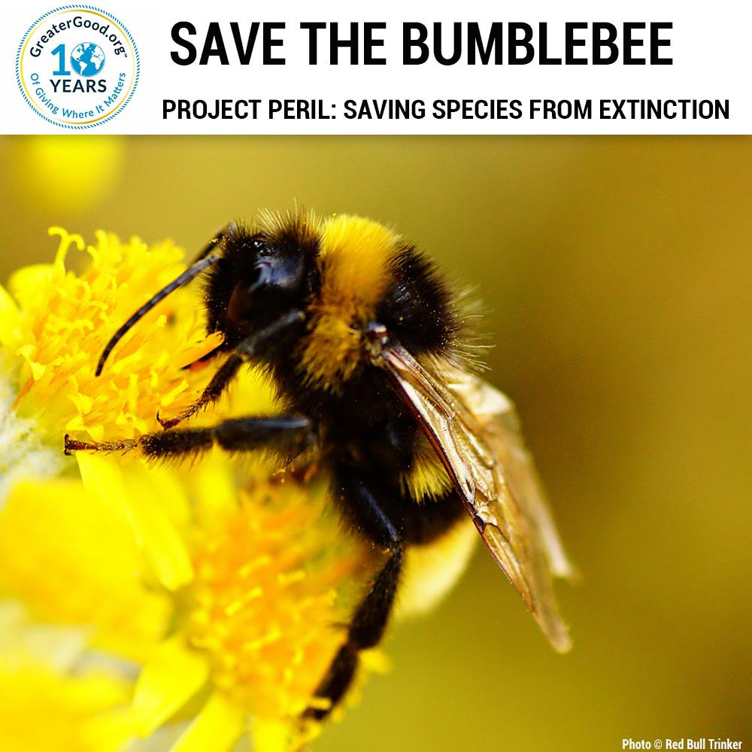
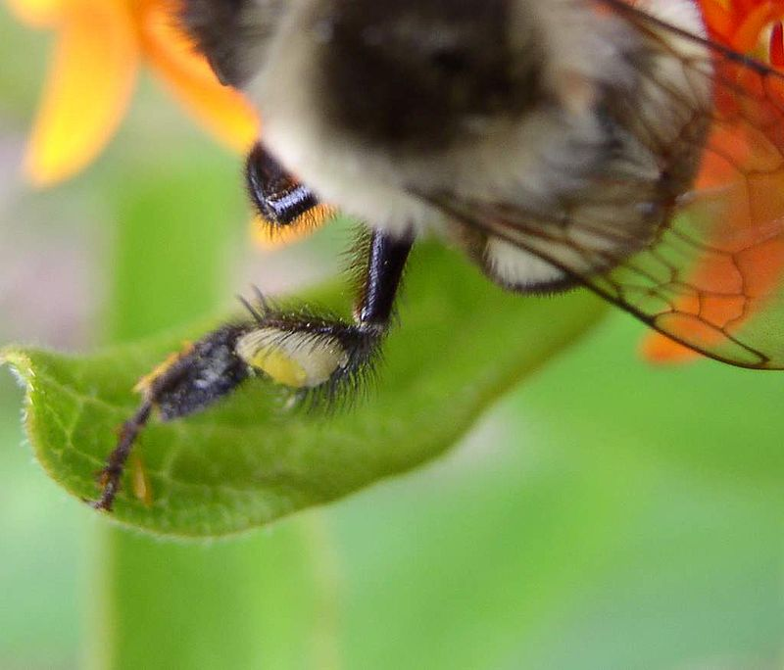
BUMBLE BEES
Hind legs

Slide 8
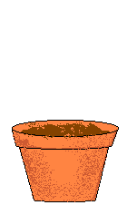
type of intermediaries/pollinators.

Slide 9
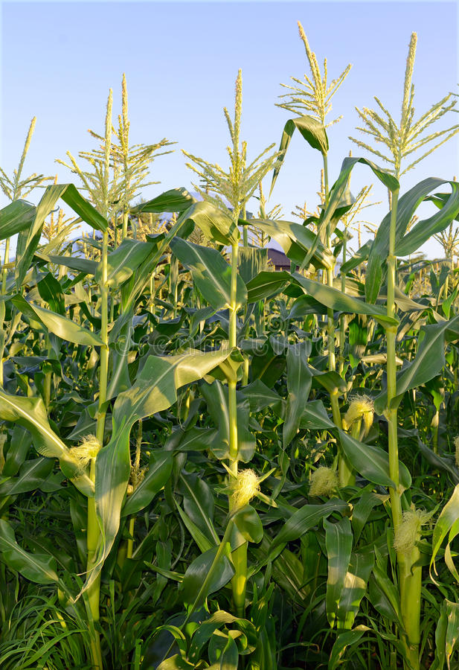
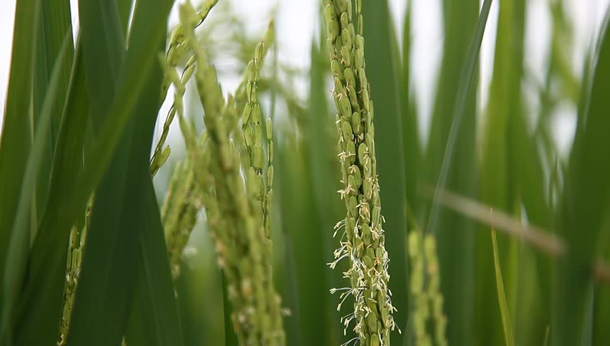
anemogami
Have you ever observed of corn or rice?
JAGUNG
NASI

Slide 10
ANEMOGAMI
Pollinated by the wind.
The traits of plant with flowers are small and lightweight and also do not produce nectar or odors.

Slide 11
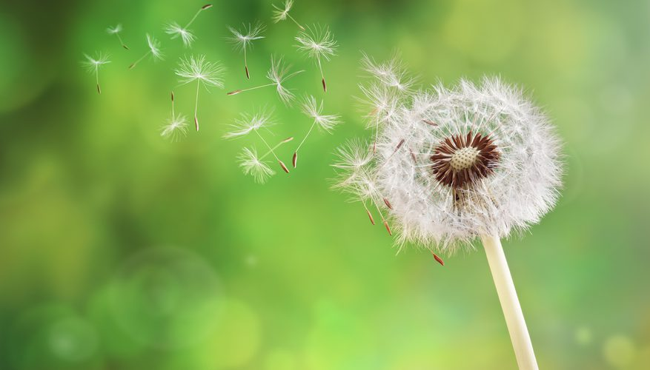
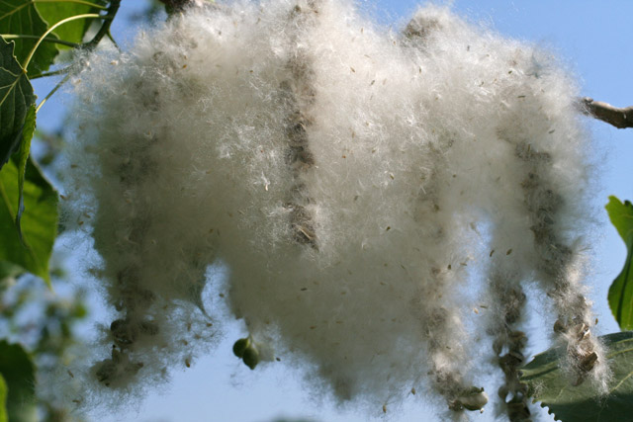
BUNGA DANDELION
Cottonwood

Slide 12
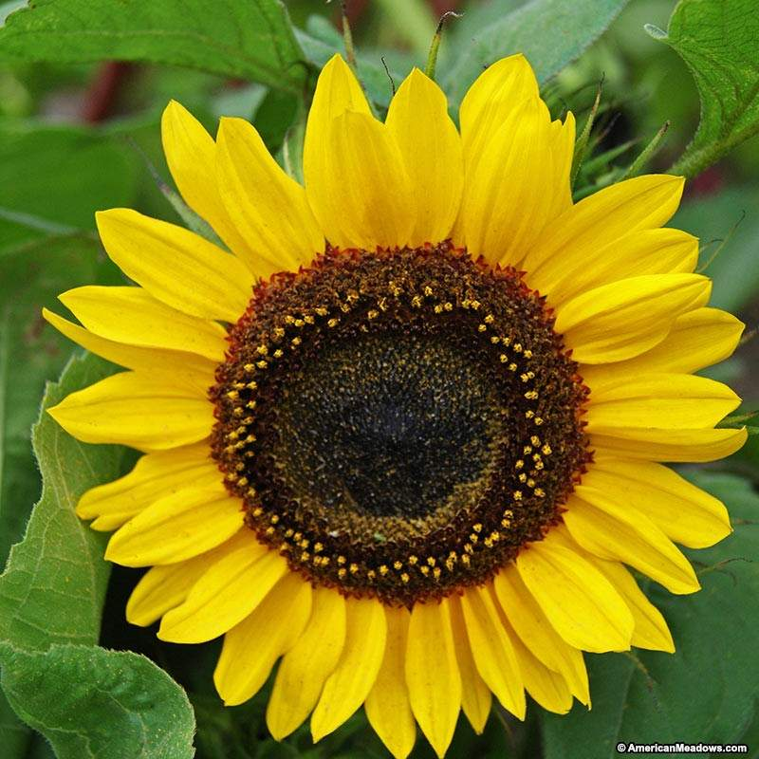
ENTOMOGAMI
What did you notice in this sunflower?
Do you know what the function of these traits for sunflower?

Slide 13
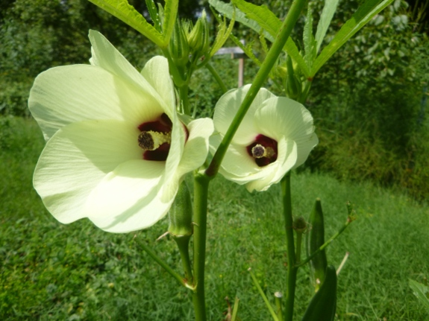
ENTOMOGAMI
Pollinated by the insect
OKRA (Bunga Okra)
POLLINATORS:
Honey bees and solitary bees (Lebah)

Slide 14
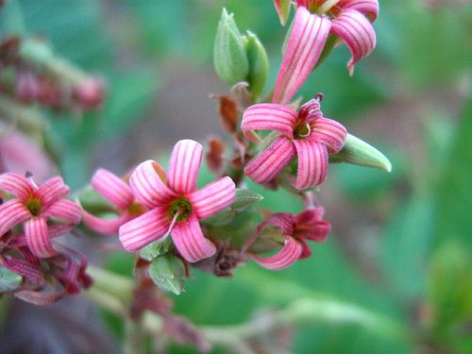
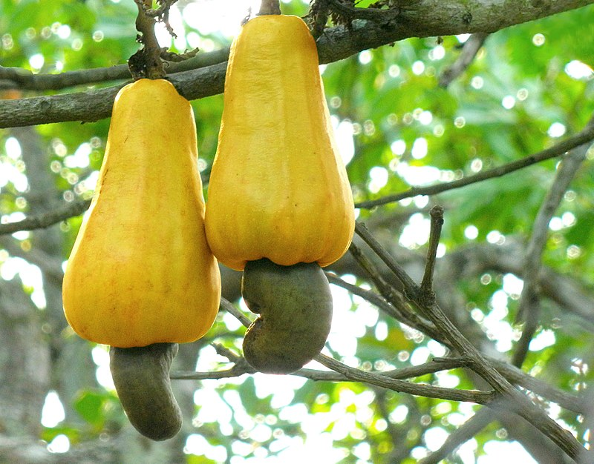
CASHEW (JAMBU METE)
POLLINATORS:
Honeybees (lebah madu) butterflies (kupu-kupu)
flies

Slide 15
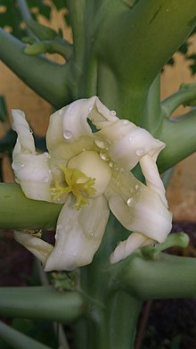
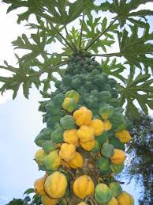
PAPAYA (PEPAYA)
POLLINATORS:
honeybees (lebah madu)
butterflies (kupu-kupu)
moths (ngengat)

Slide 16
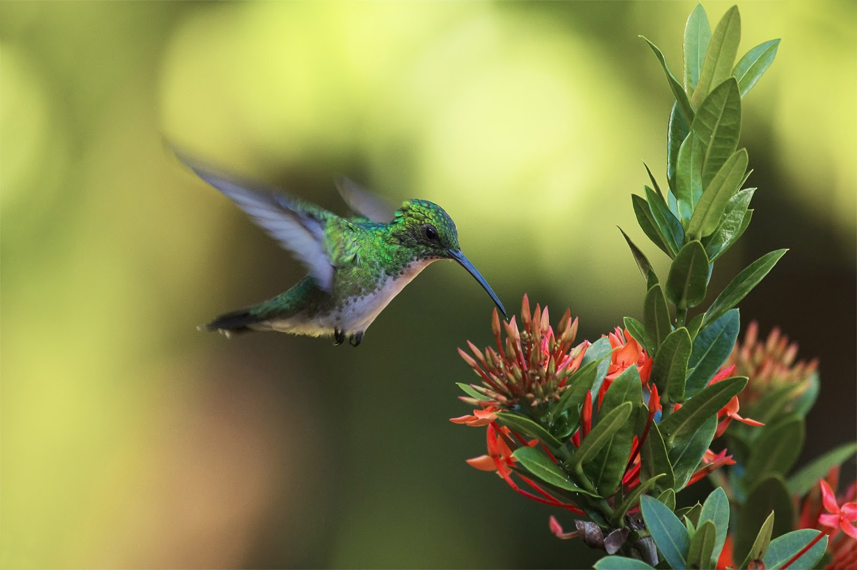
ORNITOGAMI
Pollination by birds
Plants that make use of pollination by birds commonly have large flower size bright red, orange or yellow flowers and very little scent.

Slide 17
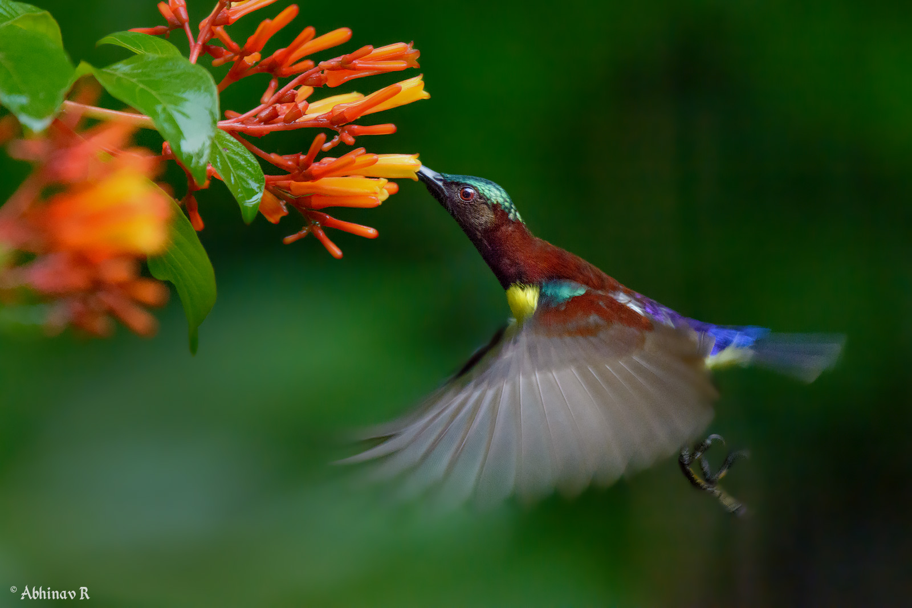
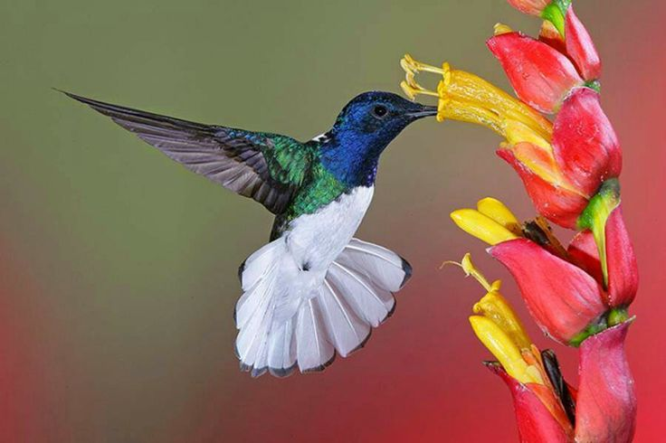
Sunbird
Jacobin bird (burung Jacubin)

Slide 18
KIROPTEROGAMI
Pollination by bat
Plants pollinated by bats often have pale nocturnal flowers (in contrast, bees are mostly attracted to bright, daytime flowers). These flowers are often large and bell shaped, and some bats have evolved specifically to reach the nectar at the bottom of them.

Slide 19
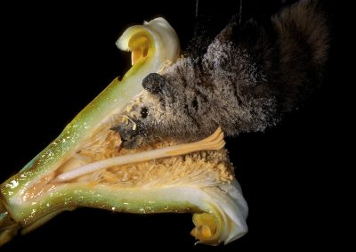

Slide 20
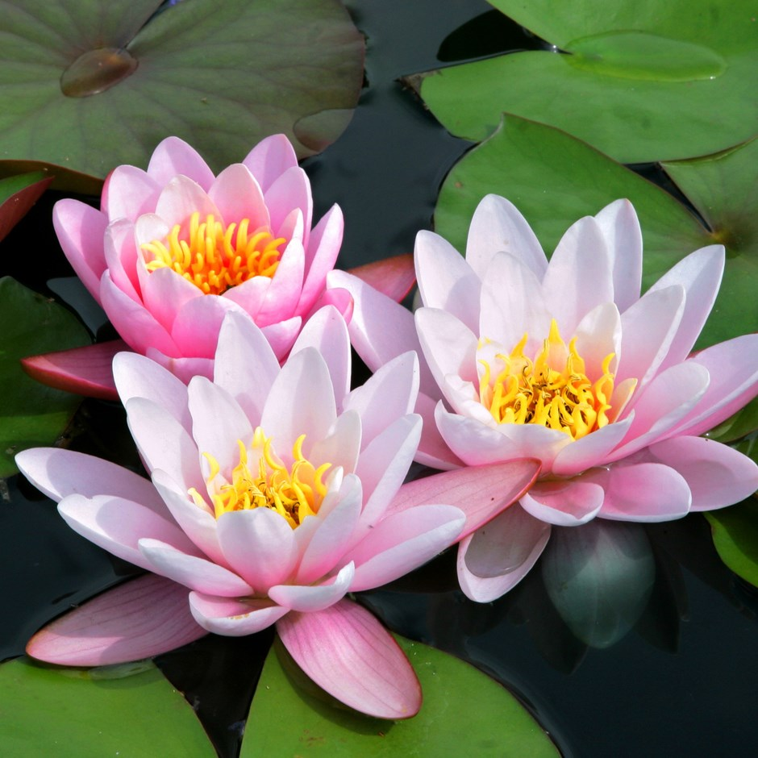
What flowers are bats attracted to?
Bats are attracted to night blooming flowers.
WATER LILY (TERATAI)

Slide 21
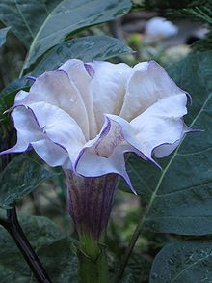
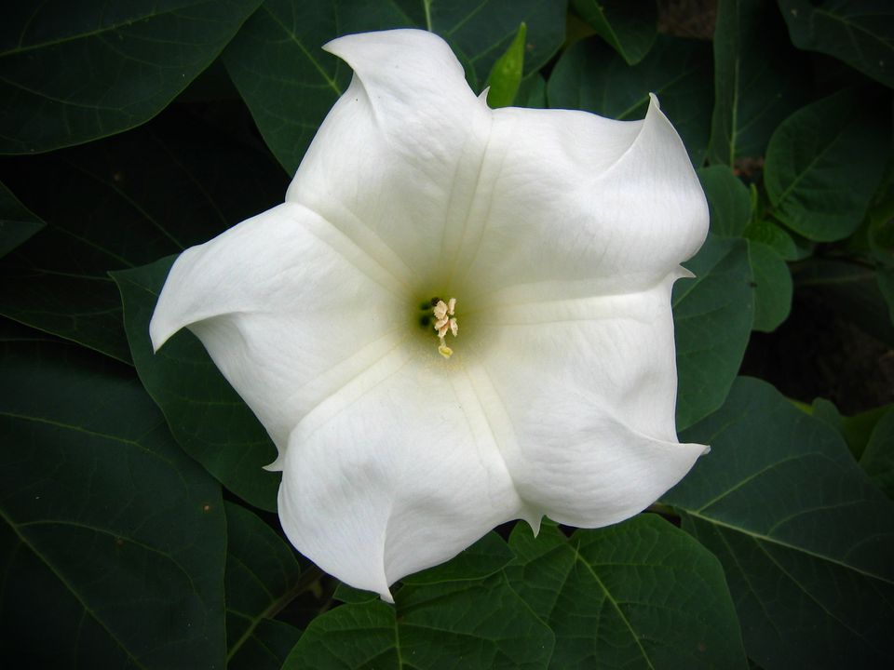
DATURA
MOONFLOWER

Slide 22
ANTROPOGAMI
Pollinated assisted by human
How antropogami done?
It is done usually when the flowers are married two.

Slide 23
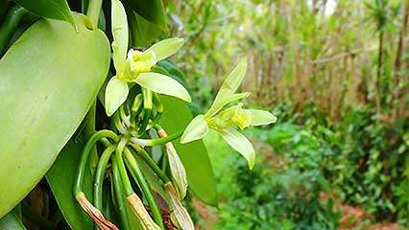
VANILLA PLANT

Slide 24
TYPE OF POLLINATION

Slide 25
SELF-POLLINATION
It is a transferring of the pollen's from anther to stigma is come from in the same flower.

Slide 26
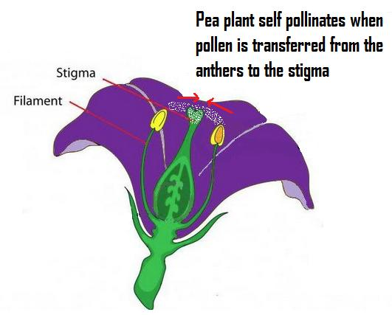

Slide 27
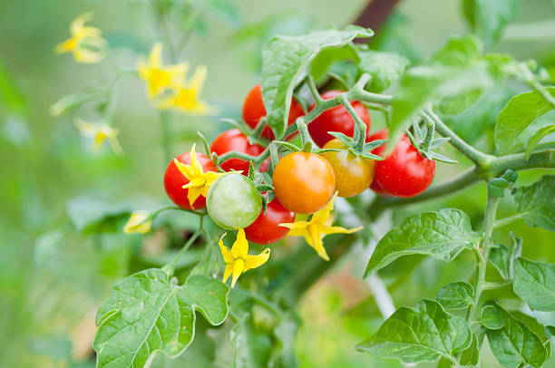
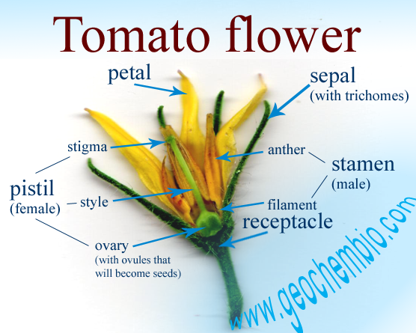
Tomatoes (tomat)

Slide 28
POLLINATION NEIGHBOR
It is happen when the pollen that sticks to the stigma comes from another flower on the same plant.

Slide 29
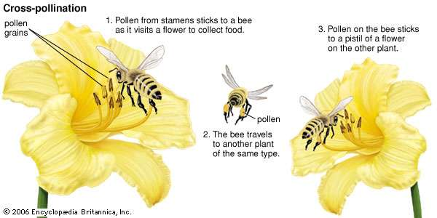
CROSS-POLLINATION

Slide 30
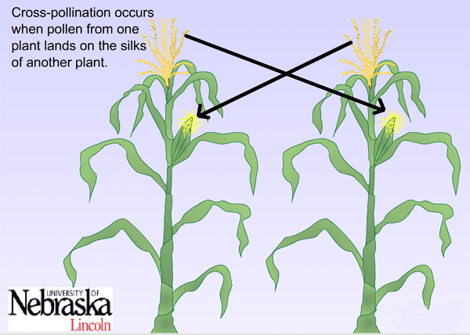

Slide 31
HOMEWORK
1. Discuss the importance of pollination?
2. Explain the role of pollination in plants?

Slide 32



